Slide 1
Kentucky HBPA Website
Planning
Tech Lithe Creations
Notes:
Tyler

Slide 2
Agenda
Current Issues
Requirements for KY HBPA’s New System
Economic Value to KY HBPA
Prototypes
Risk Analysis
Notes:
Tyler

Slide 3
Current Issues
Data Recovery and Business Continuity are compromised
The website needs to refine some desired pages, such as an “about us,” calendar of events page, and a board members page.
Postage costs are higher than they need to be, due to a lack of online newsletter.
The KY HBPA is currently unable to accept online donations.
Notes:
Cameron

Slide 4
Requirements for KY HBPA’s New System
System will include cloud storage system and a new and improved website
The cloud storage system will backup all important data
The website will have:
“About us” page
Board member biography page
Calendar of events page
Membership benefits and outline of membership requirements page
Pages with forms, so members can register online
Page with meeting minutes between the horsemen committee members
Capability of pushing content and news to users.
Capability of generating reports to users
Incorporation with an online payment system
Page with links to partner organizations such as TAA, the KY Race Tracks, and contact information for each partner
Notes:
Savanah

Slide 5
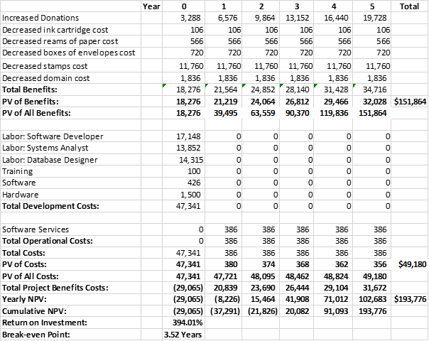
Economic Value to KY HBPA
Economic Feasibility:
How it will lower costs or increase revenue?
Focus on:
Increasing donations
Reducing printing and mailing cost
Break-even: 3.5 years
1st Year Net Cost: $29,065
5th Year Net Benefit: $193,776
394% return on investment
Notes:
Joseph

Slide 6
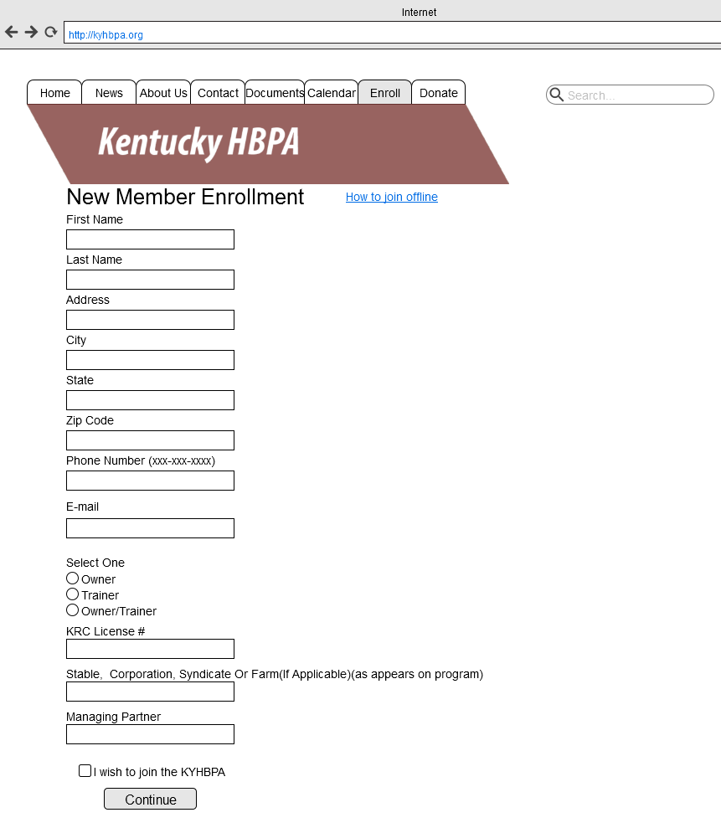
Prototypes
Notes:
Ryan

Slide 7
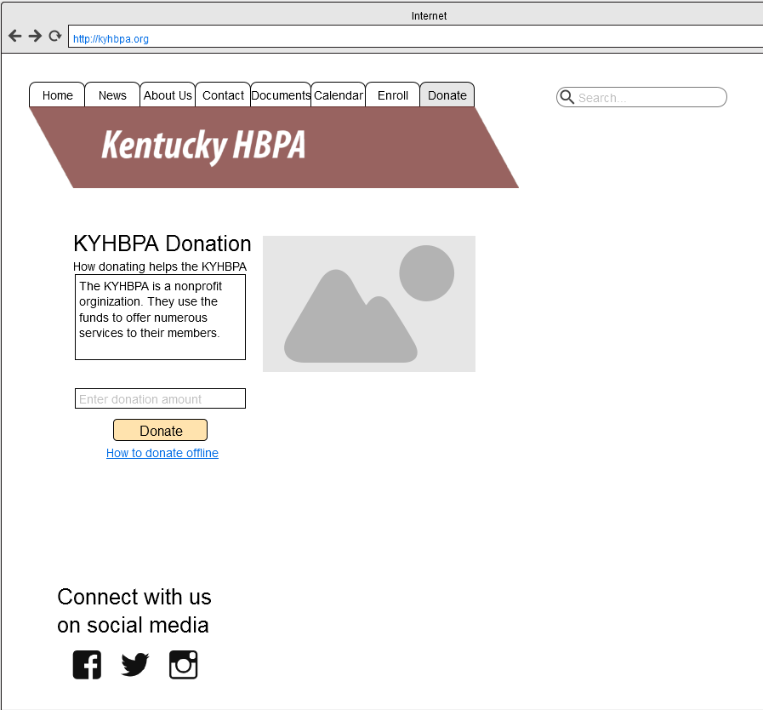
Prototypes
Notes:
Ryan

Slide 8
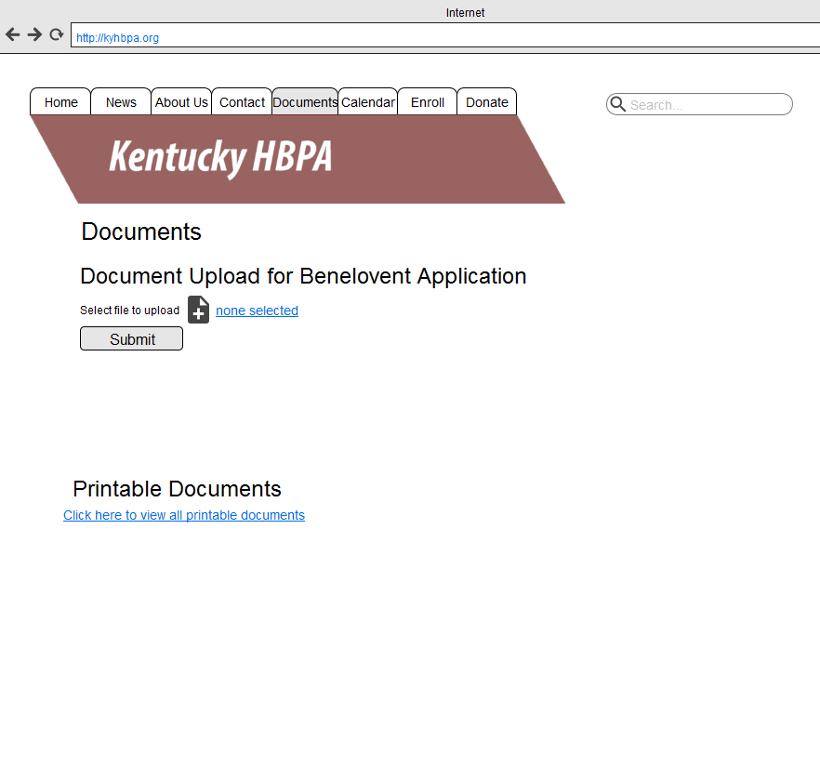
Prototypes
Notes:
Ryan

Slide 9
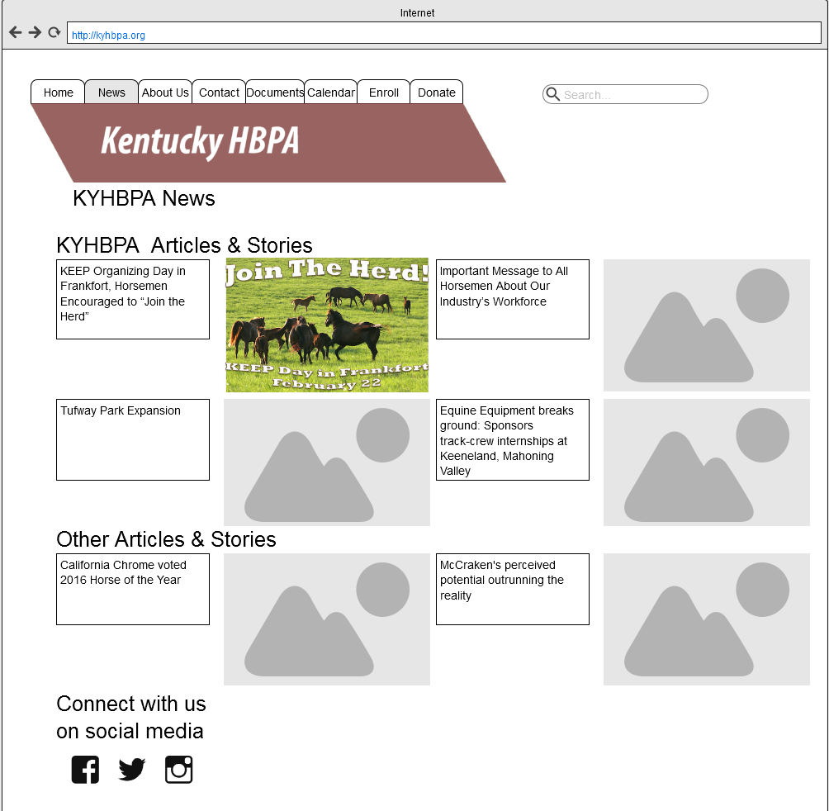
Prototypes
Notes:
Ryan

Slide 10
Risk Analysis
RISK 1: The implementation of the new website will be slowed in large by the organization’s overall lack of technical skills.
RISK 2: The development of the system will likely be slowed because the project team is new to design process.
Notes:
Zac

Slide 11
Agenda
Costs - 1st Year Cost: $47,351 ◘ 5th Year Net Benefit: $193,776
Current Issues
Requirements for KY HBPA’s New System
Economic Value to KY HBPA
Prototypes
Risk Analysis
394% return on investment
Break-even: 3.5 years
Notes:
Tyler

Slide 12
Questions?
Notes:
Tyler

